Slide 1
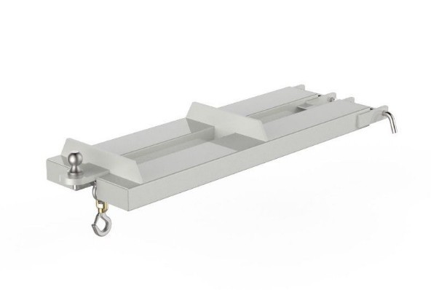
20A-JST-B01 Flat Towing Jib
APPLICATIONS
Cascade offers a number of fork mounted jib cranes that quickly convert a lift truck into a mobile crane to easily move non- palletised product. A variety of Jib Crane models for practically any application to increase lift truck versatility.
Models include Multi-Angled, Flat, Slip-On, or Carriage- Mounted, allowing for effective slinging of loads beneath a hook.
The standard finish on this attachment is zinc.
SPECIFICATIONS
SWL
Towing Capacity
H C of G
V C of G
Weight
Fork Pockets
Pocket Centres
Drawing Ref
DIMENSIONS
LENGTH
HEIGHT WIDTH
2000kg
500kg
656mm
23.5mm
50kg
120x40mm
108mm (ITI) SK-27947
1365mm
154mm
420mm
Note: All lift truck attachments affect the safe working load of a lift truck.
End users should consult their lift truck supplier to ensure the lift truck is rated for use with these attachments. In the case of a slung load when lifting a jib
attachment, the net lifting capacity should be 0.8 times the rating of the lift
truck to allow for the swinging load. Please consult your local lift truck dealer.
FEATURES & BENEFITS
■■ Pocket size to suit most fork section sizes.
■■ Fork Arm Retaining Toggles
■■ Safety Swivel Hook supplied standard
■■ Two Lifting Points
SAFE WORKING LOAD (SWL) PER POSITION
POSITION
1
2
TOWING CAPACITY
SWL (kg)
2000
2000
500
EXTENSION (mm)
575
1160
1265
HANDLING SYSTEMS AUSTRALIA — P h: 08 9458 7933 — EMAIL: SALES@HSSALES.NET

